Slide 1
Solar System Pipeline
Group-2

Slide 2
Team
1 | Shaimaa Mahmoud Elsaadi Seif
2 | Ahmed Khaled Mohamed Gamal
3 | Marwa Magdi Zaki Mohamed
4 | Muhammed AbdelGhafar Muhammed

Slide 3
Agenda
1 | Project brief
2 | Pipeline Architecture
3 | Jenkins
4 | CI-CD Pipeline
5 | CI Pipeline
6 | CD Pipeline
7 | Demo

Slide 4






Project brief
Project
Build
Test
Containerize
Provide
infra
Configure
infra
Deploy app

Slide 5
Jenkins
Structure | Master node only
Credentials | AWS keys-SSH-Docker-Mongo...
Plugins | SSH-Nodejs-Terraform-Ansible...
Triggers | Github-webhook

Slide 6





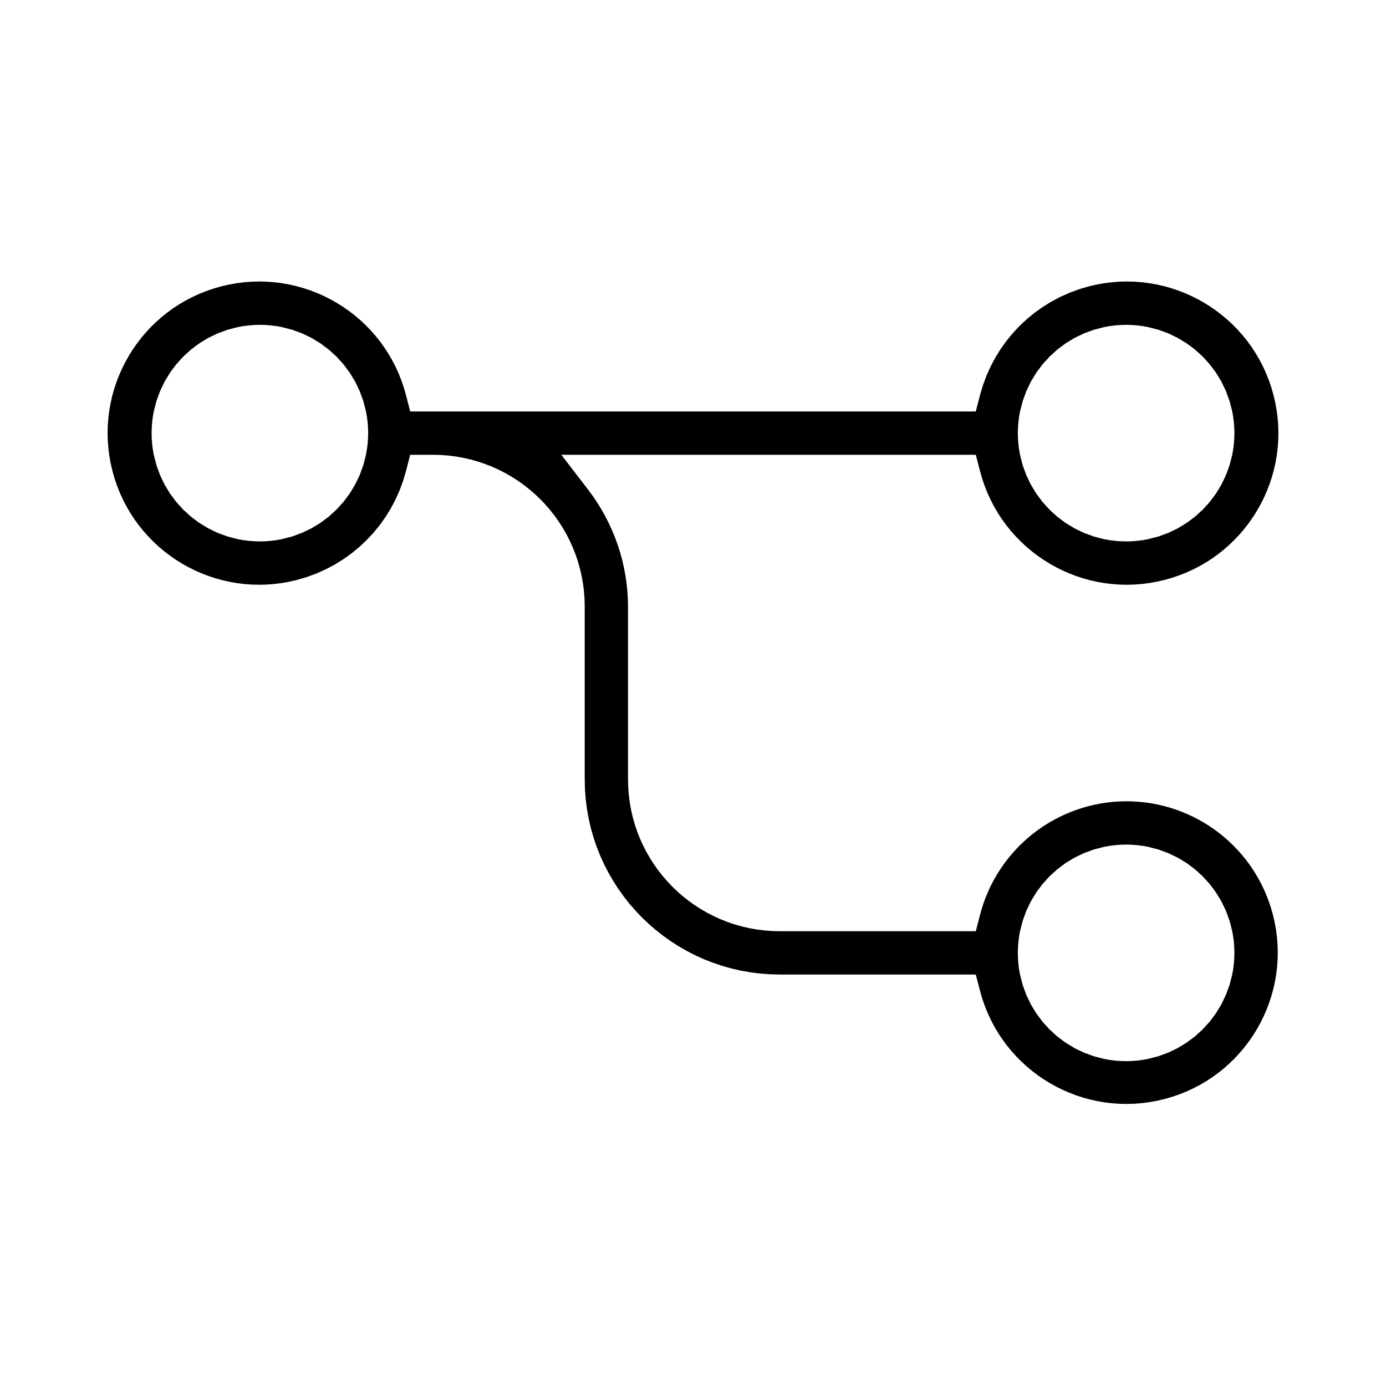




docker
CI-CD
Pipeline
BUILD:
Cleanup
Prepare Jenkins Inputs
Install Dependencies
-----------------------
Remove Old Artifacts
Build Docker Image
Docker-login
Push Docker Image
Test Docker Container Local
GitHub
Test:
Run Unit Tests
Run Code Coverage
-----------------------
main
Merge
Trigger pipeline
Dev
Pass
Aws Credential
Terraform Init
Terraform refresh
Terraform apply
Pull
Image
Notify
Notification mail
Prod
Pull
Request
Terraform Output
Containerize:
Push Image-----------
-----------------------
Deploy:
Provisioning ----------
Configuration
SSH credential
Ansible Playbook

Slide 7
CI Pipeline

Slide 8
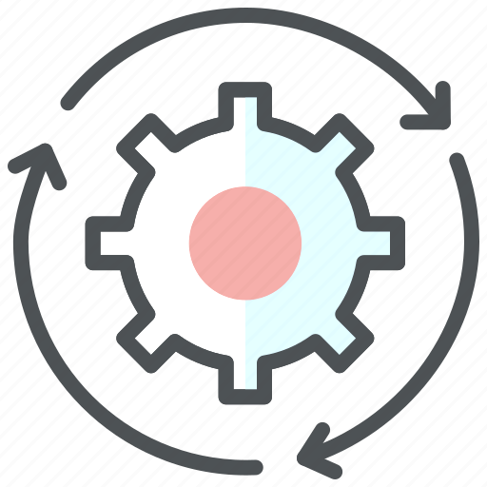
Build
Cleanup | Delete dirctory
Prepare Jenkins Inputs | Github credential Clone repo
Install Dependencies | # npm install

Slide 9

Test
Unit Test | #npm test
Code Coverage | # npm run coverage Coverage Report (lines>70%)

Slide 10
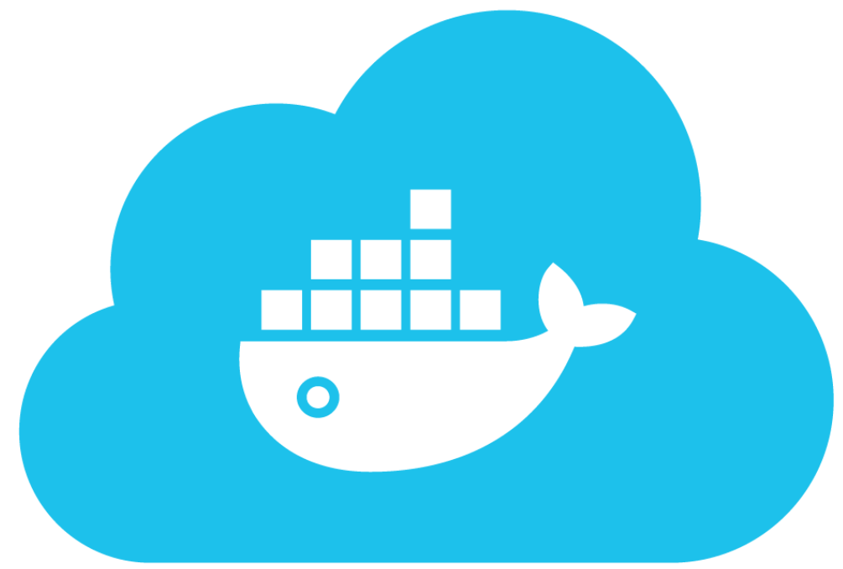
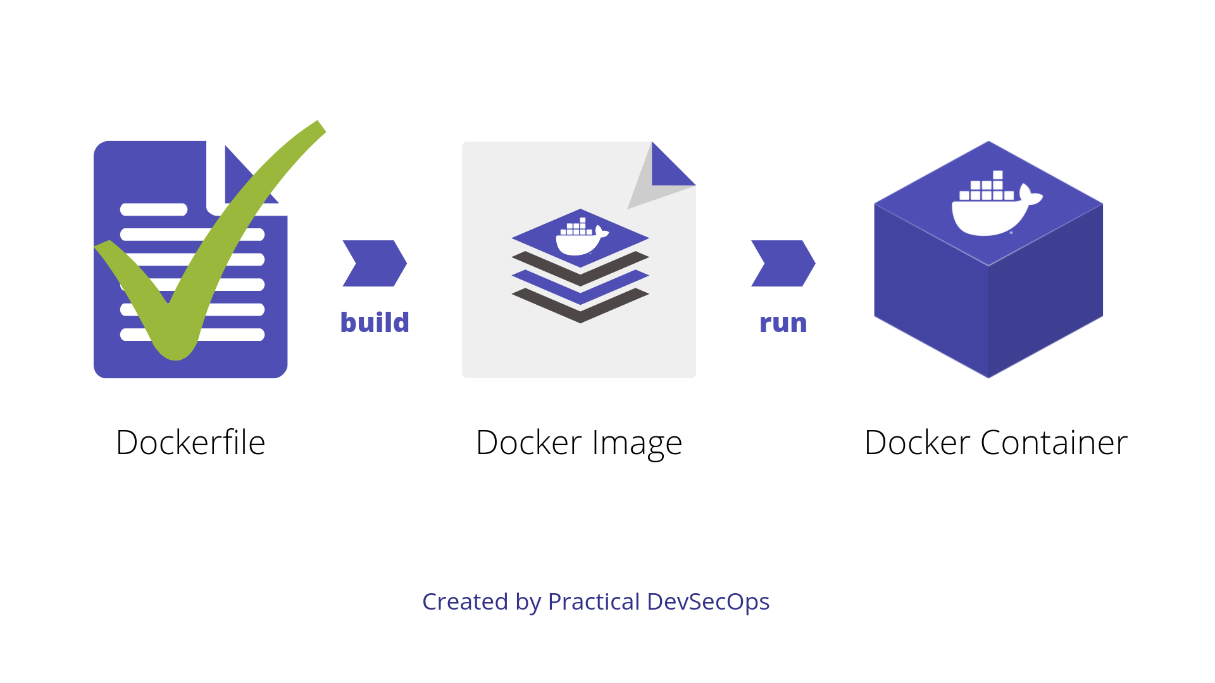
Containerize
Remove Old Artifacts Build Docker Image | Remove old image Build docker file with BUILD_NUMBER Tag
Docker-login Push Docker Image | Docker credential Push image to docker Hub
Test Docker Container Local | Run container Crul http://localhost:3000

Slide 11
CD Pipeline

Slide 12
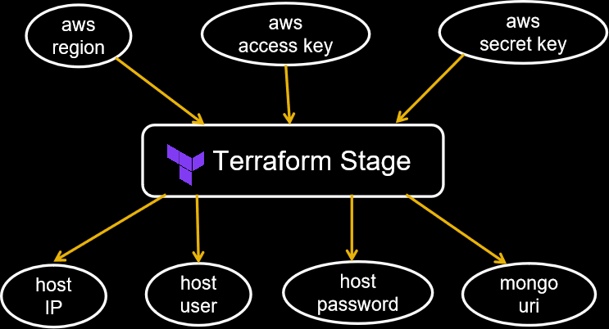
Terraform

Slide 13
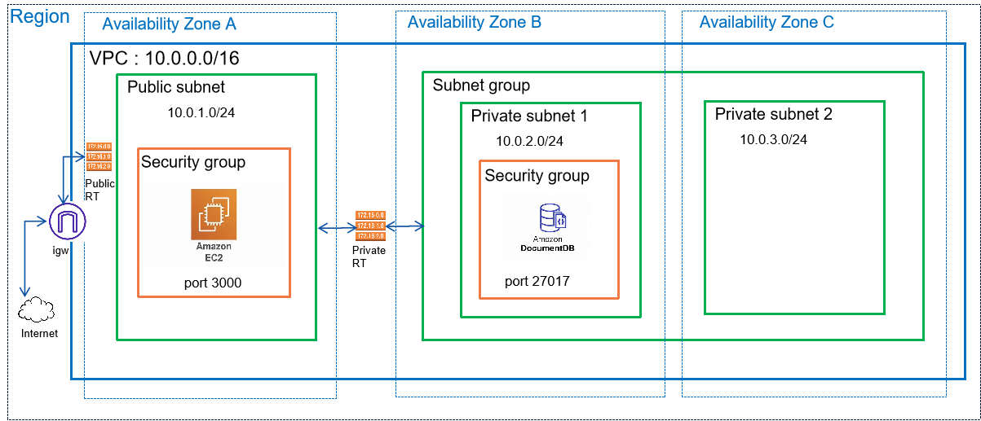
AWS Architecture

Slide 14
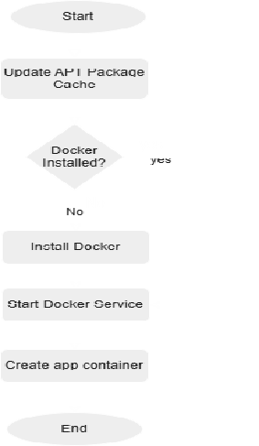
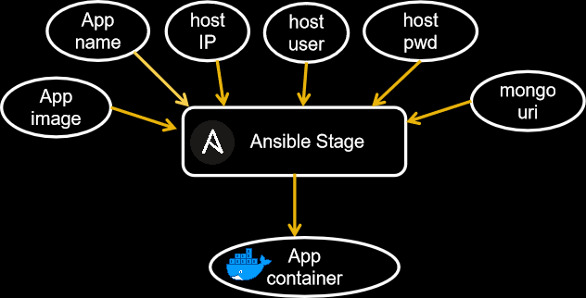
Ansible

Slide 15
Questions?

Slide 16
Thanks!

Slide 17
DEMO
3, 2, 1… Take off to the Solar System! http://18.217.68.10:3000/

